Slide 1
GCLK – Generic Clock Controller
Thomas Müller, muellet5@students.zhaw.ch

Slide 2
Content
GCLK overview
Clock sources
Generic Clock Generator
Generic Clock Multiplexer
Synchronization
Registers
Programming API
Demo

Slide 3
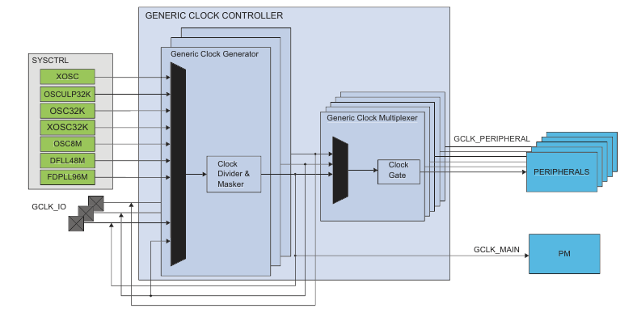
GCLK Overview

Slide 4
Clock Sources
XOSC: 0.4 – 32MHz tunable crystal oscillator
OSCULP32K: 32.768kHz ultra low power internal oscillator
OSC32K: 32.768kHz high accuracy internal oscillator
XOSC32K: 32.768 crystal oscillator
OSC8M: 8MHz internal oscillator
DFLL48M: 48MHz digital frequency locked loop
FDPLL96M: 48 – 96MHz fractional digital phase locked loop

Slide 5
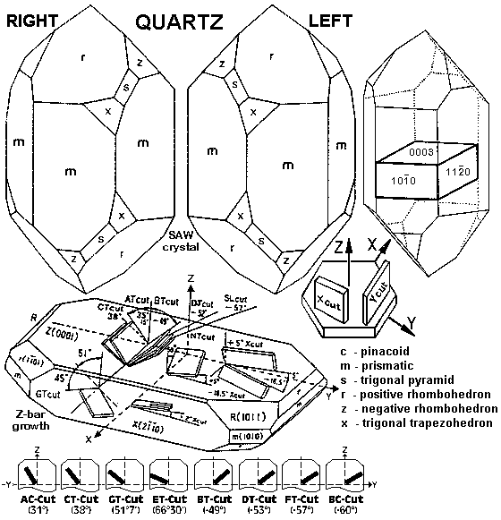
Clock Sources::Crystal Oscillator
Vibrating crystal of piezoelectric material
Frequency depending on crystal cut
Most common application: 32.768kHz
Watches
Low frequency XY-cut

Slide 6
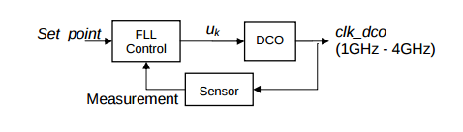
Clock Sources::Digital Frequency Locked Loop
Electronic control system
Input: Reference Clock
Digitally-controlled oscillator (DCO) generates output frequency
Feedback measurement for FLL control

Slide 7
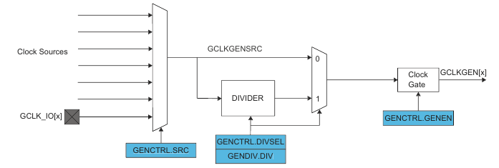
Generic Clock Generator
Each generator can be set to run from one of eight clock sources
Except GCLKGEN[1]: act as source to other generic glock generators

Slide 8
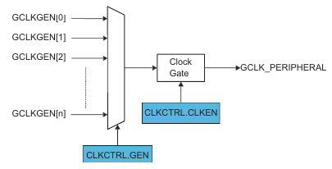
Generic Clock Multiplexer
Assign a clock source (generator) to peripheral
Changing source for peripheral requires disabling the generic clock (over CLKCTRL.CLKEN)

Slide 9
Synchronization
Registers can require synchronization on read / write access
If synchronization required STATUS.SYNCBUSY is one → bus stalled
CPU stalled as long as bus stalled
→ no interrupts can be handled
Refer to processor handbook to find out which register access needs to be sync
Be careful with slow clock sources (32kHz)

Slide 10
Registers
CTRL: SWRST flag
STATUS: SYNCBUSY flag
CLKCTRL
GENCTRL
GENDIV

Slide 11
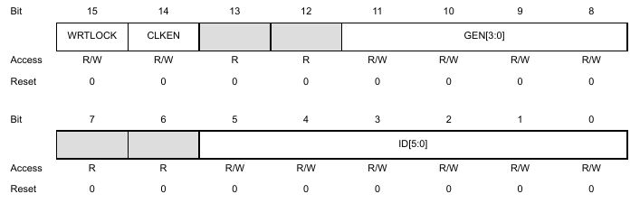
Registers::CLKCTRL
Enable Clock
Assign Generator to device

Slide 12
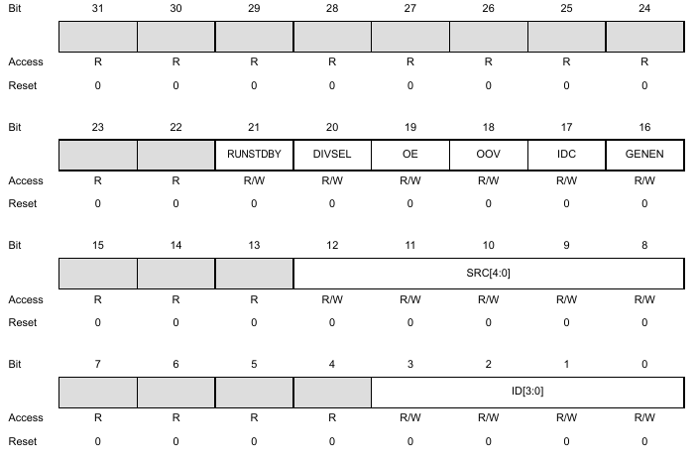
Registers::GENCTRL
Configure generic clock generator
Assign clock source to generator

Slide 13
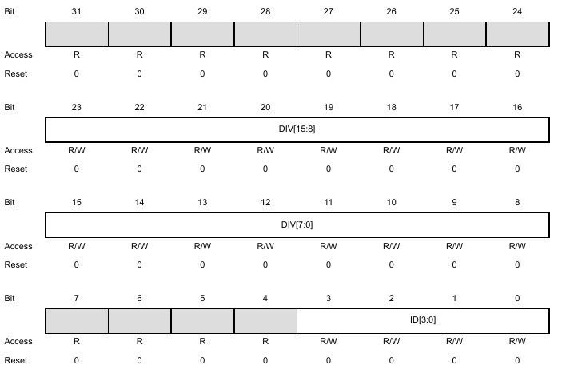
Registers::GENDIV
Assign division factor to specific clock generator

Slide 14
Programming API
Assign clock source to generator:
sys::reg::GCLK.src2gen(SRC,GEN,flags);
SRC can be OSC8M, OSC32K etc.
GEN can be G0 to G8
Assign clock generator to device:
sys::reg::GCLK.gen2dev(GEN,DEV);
GEN can be G0 to G8
DEV can be ADC, TC (Timer Counter) etc.
Set division factor:
sys::reg::GCLK.gendiv(GEN,DIV);
GEN can be G0 to G8
DIV is 16Bit division factor

Slide 15
DEMO

